Slide 1
Maker’s Valley - Transportation
Team 3 . 5

Slide 2
Introduction
Maker’s Valley is a sector of inner Johannesburg, distanced 30 minutes by bus or 15 minutes by drive from the CBD. The name of Maker’s Valley derives from the decades of culture in the field of creation, and is now becoming even more prominent than ever in the area.
Current features include:
Small Scale Crafts
Artisans
Gardeners
Creatives

Slide 3
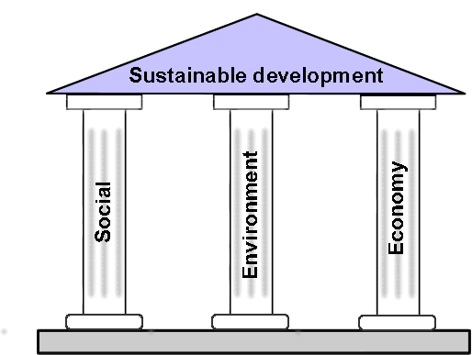
Aim
Improve and Address key themes which affect Transport in Makers Valley:
Sustainability
Economical restraints
Safety
Efficiency
Accessibility

Slide 4
Solution
Our solution is a cycle hire scheme using bicycles made from recycled materials, taking the circular economy into consideration making the bicycles sustainable.
The scheme is free for people in education in order to make it easy for students to have a way to travel to and from school. However users that are not in education will be able to pay a small fee to be able to rent the bicycles (the fee is TBD, as we will need to ask the users a price that they will be willing to pay).
To keep safety in mind we will have helmets attached to the bicycles and in order to ensure that they stay with the bicycles we will design/implement a system similar to how trolleys in supermarkets work

Slide 5
Solution - How Does it Work?
Our solution works by creating bicycles made from recycled and/or sustainable materials, these bicycles could use recycled metals for frames or potentially looking into materials such as using wood, bamboo or recycled plastic for the frames. One of main reasons as to why Bamboo would be beneficial, is because research states that bamboo is a plant that grows relatively quickly, whilst still being one of the highest absorbers of CO2. In addition to this, bamboo is one of the fastest growing plants on the planet (meaning gaining a supply of it would not be as hard relative to any other raw materials).
The solution would create jobs as the bicycles would be manufactured locally, and jobs would continue to be made as the bicycles would have to be maintained.

Slide 6
Solution - Target Audience
The biking scheme, whilst open to the entire demographic of Maker’s Valley and its surrounding area, is mainly targeted for those in education or those commuting from points of recreational activities to Maker’s Valley Itself:
Youth
Students
Young professionals
Workers

Slide 7
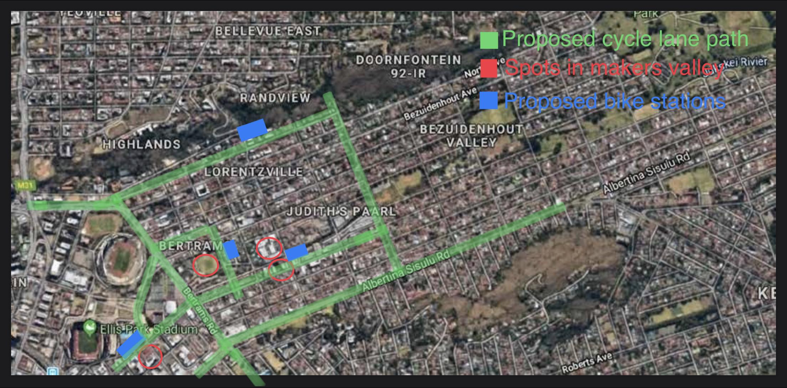
Solution - Mock Up

Slide 8
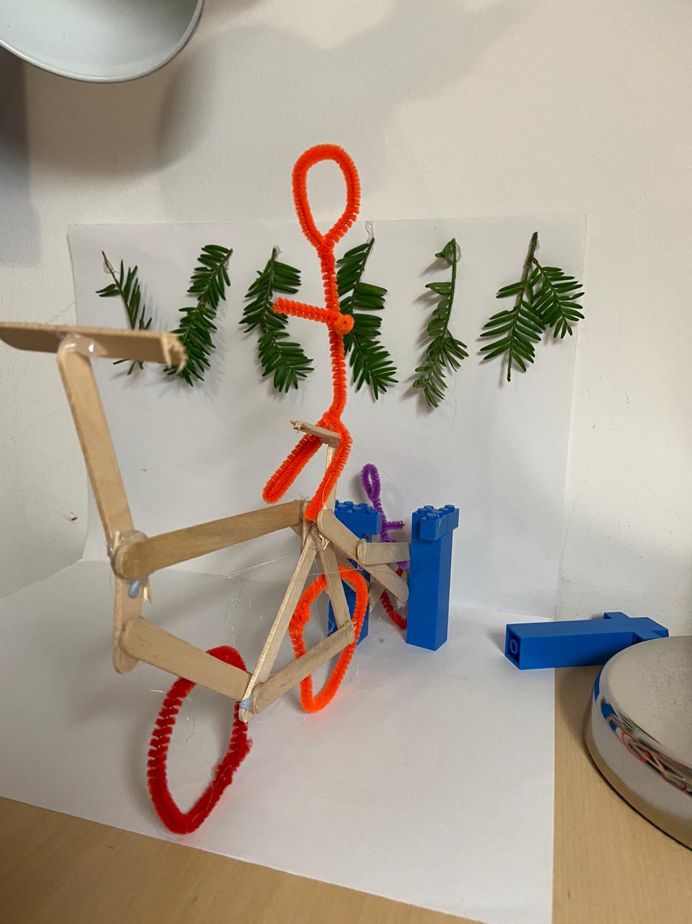
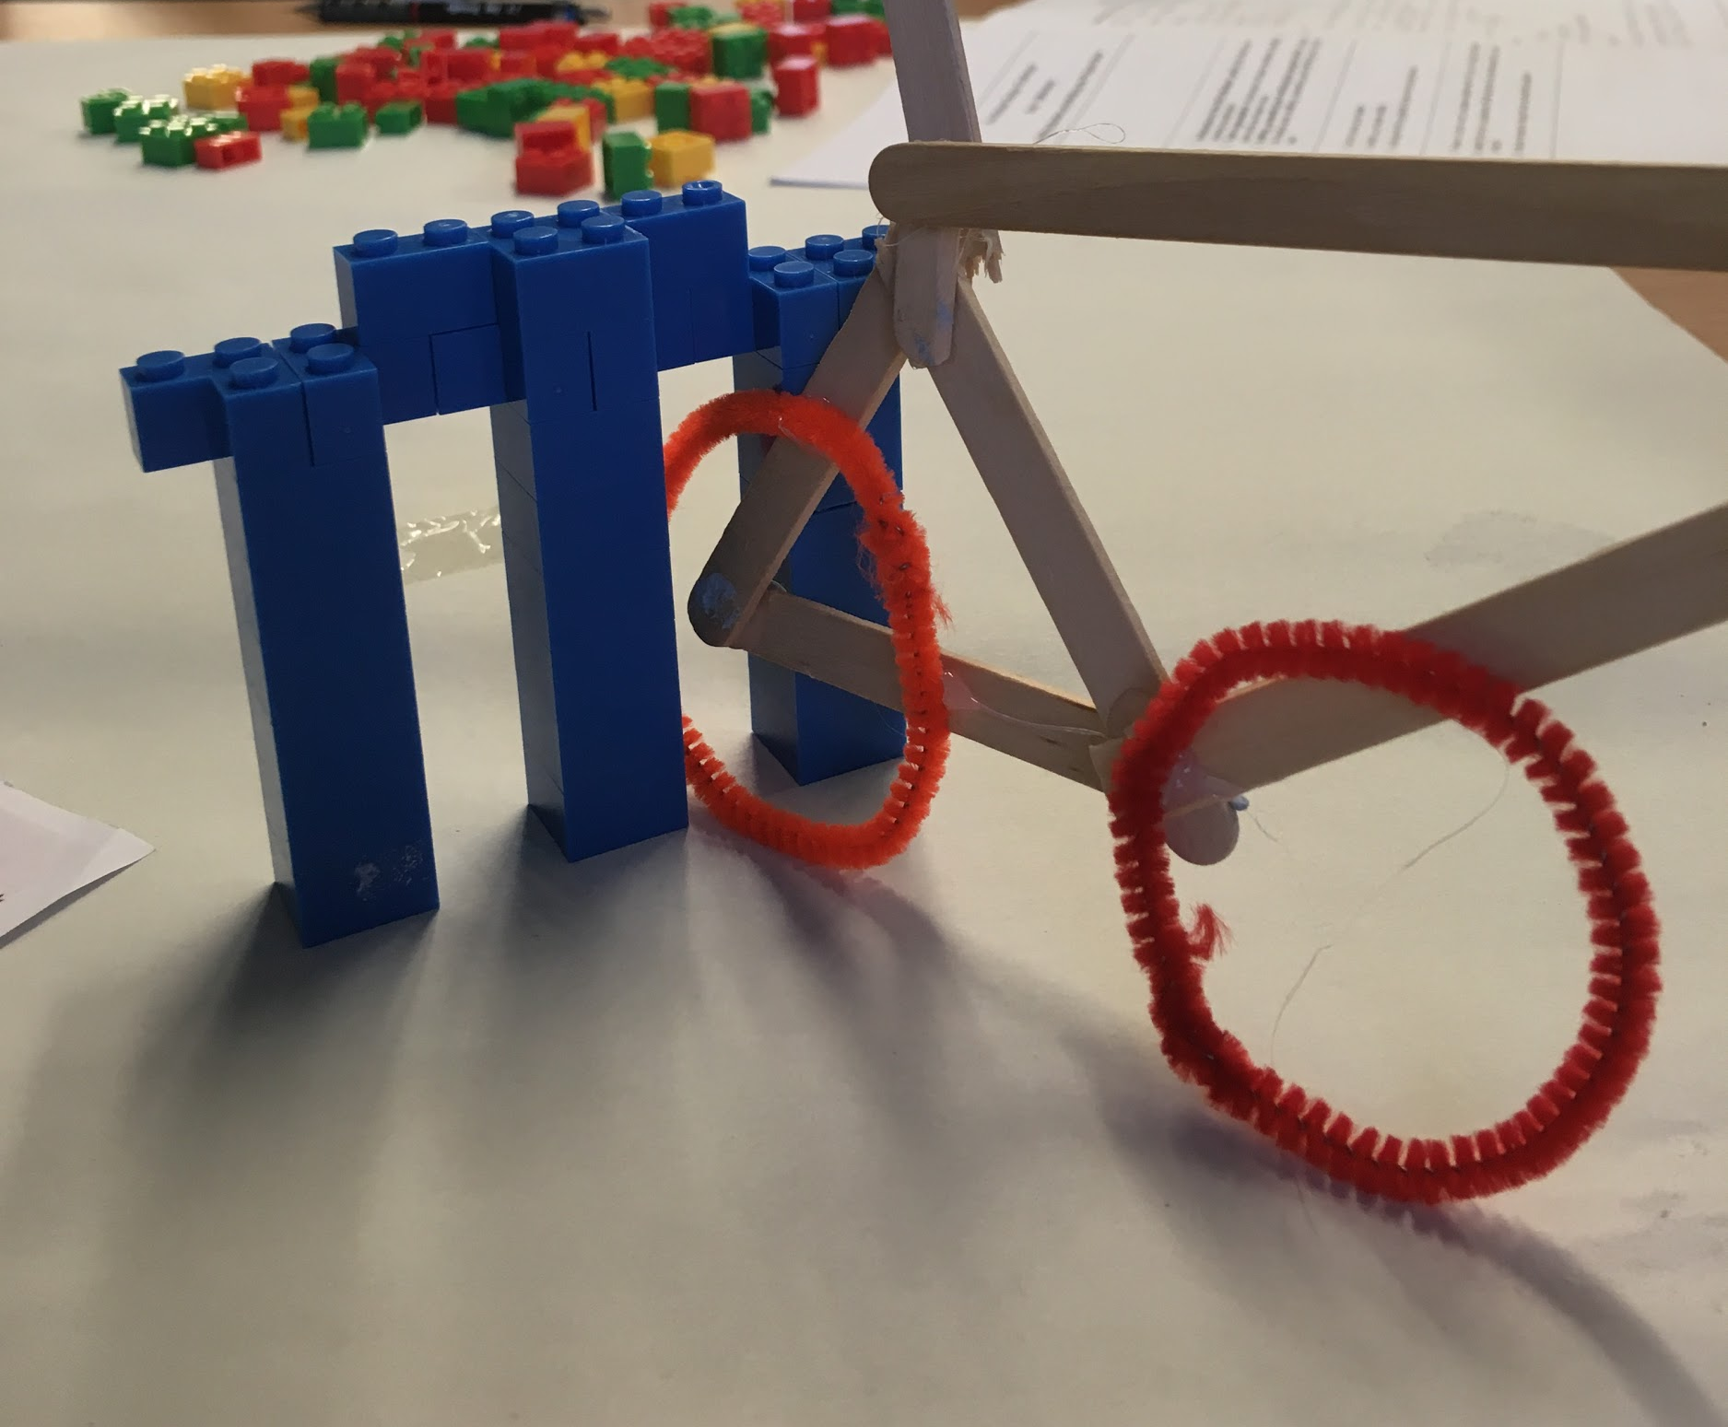
Solution - Mock Up

Slide 9
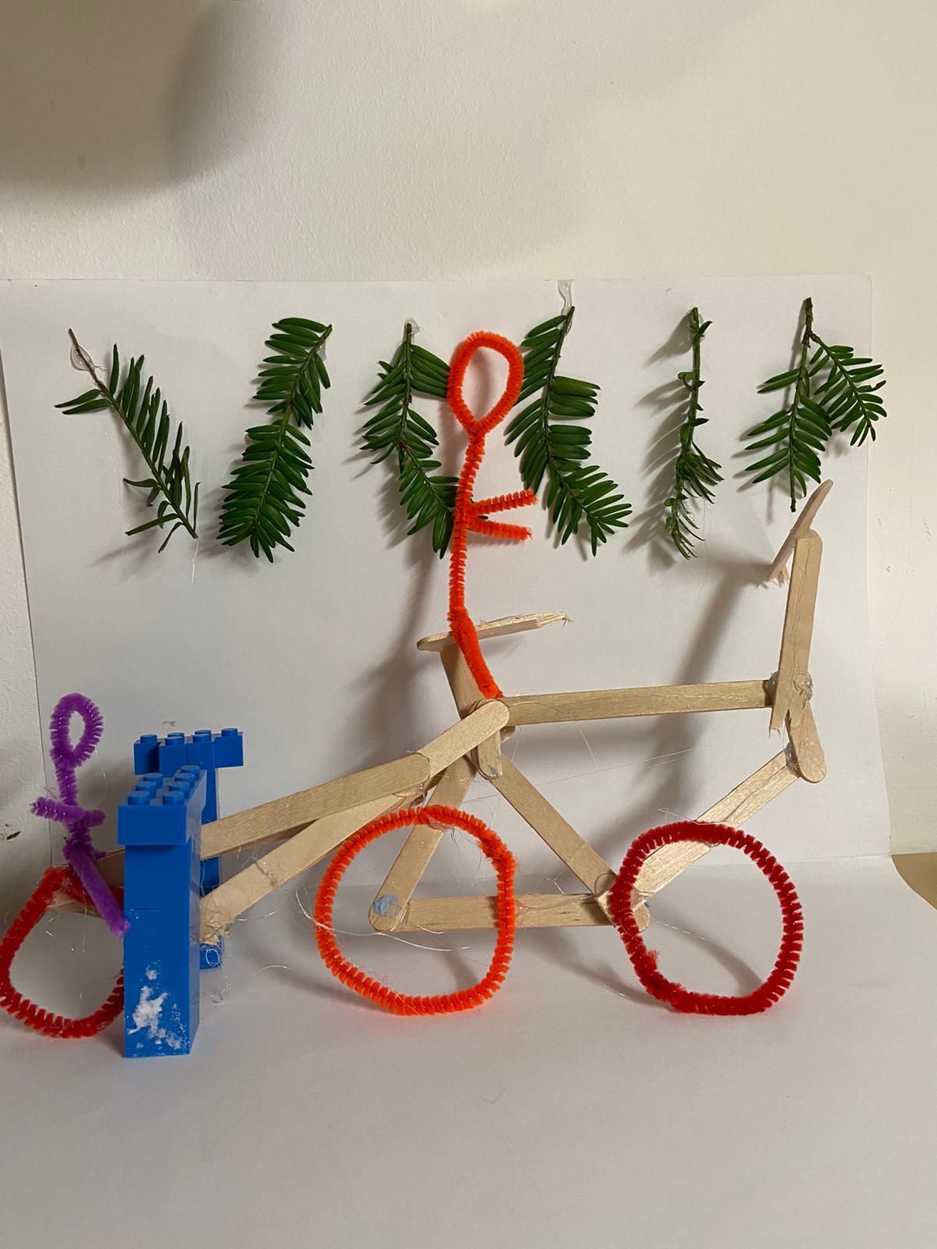
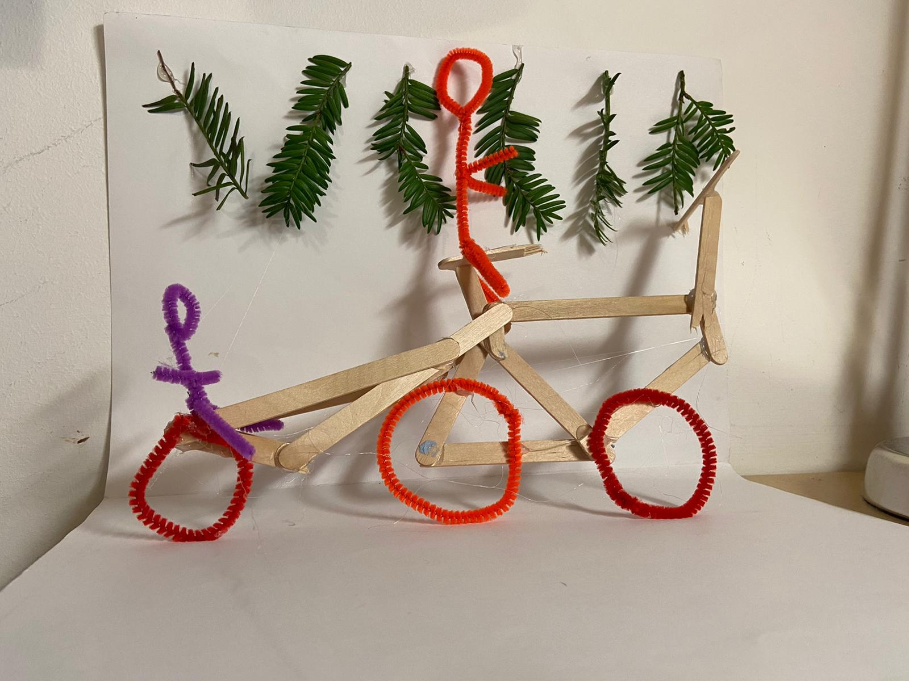
Solution - Mock up (cont)

Slide 10
Fin.

